Slide 1
STRUCTURE MODELLING AND COMPARISON OF THE ACTIVE SITES OF SIK1B AND DIFFERENT ISOFORMS OF SIKS USING HOMOLOGY MODELLING.

Slide 2
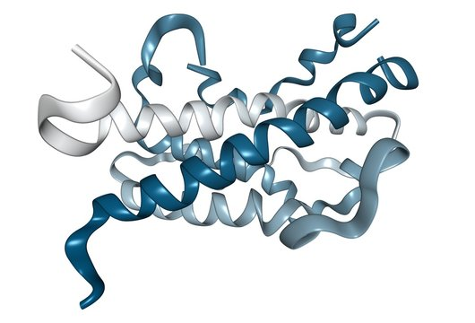
INTRODUCTION
DIFFERENT ISOFORMS OF SIKS
HOMOLOGY MODELLING
MODELLER
RESULTS
MOLECULAR DOCKING
DOCKING RESULTS OF SIK1 VS SIK1B
CONTENTS

Slide 3
INTRODUCTION
Salt-inducible kinases (SIKs) belong to the AMPK family and regulate key metabolic processes such as lipid metabolism and gluconeogenesis.
SIKs are emerging as tumor suppressors, particularly in lung cancer, but are still understudied in diabetes and cancer therapy.
SIK1 mutations are associated with epileptic encephalopathy, while SIK2 plays a role in ovarian cancer metabolism.
The study aims to build a 3D model of the SIK1B isoform using Swiss Model and Modeller tools.
The goal is to identify active sites and ligand interactions to explore therapeutic potential of SIK1B in various diseases.

Slide 4
WHY STRUCTURE MODELING OF SIK ISOFORMS?
Lack of Crystal Structures: Limited or no experimental structures available for SIK isoforms like SIK1B.
Domain Identification: Helps identify key functional domains (e.g., kinase, ATP-binding sites).
Active Site Prediction: Visualizes ligand binding sites essential for drug design.
Therapeutic Targeting: SIKs are linked to cancer, metabolism, and brain disorders—structure reveals druggable regions.
Isoform Comparison: Structural modeling aids in comparing SIK1 vs. SIK1B to understand functional differences.
Mutation Impact Study: Predicts effects of disease-related mutations on structure and function.

Slide 5
DIFFERENT ISOFORMS OF SIKS
01
SIK1
02
SIK1B
03
SIK2
04
SIK3
gene ID 150094
gene ID 1027244284
gene ID 23235
gene ID 23387
Involved in regulating energy metabolism and tumor suppression, particularly in lung cancer
An isoform of SIK1, its structure is not well-characterized
Primarily associated with lipid and glucose metabolism, particularly in ovarian cancer.
Plays a role in lipid metabolism and inflammation suppression, especially in macrophages.

Slide 6
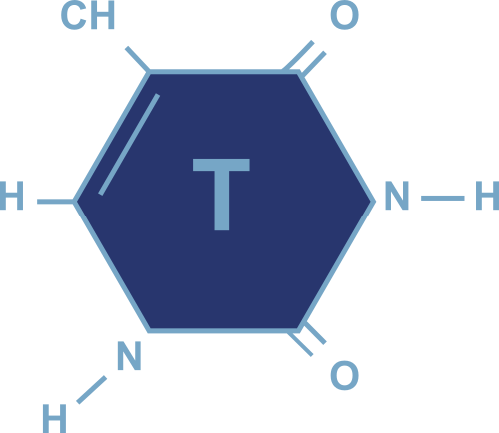
STEPS:
HOMOLOGY MODELLING
Template identification
Sequence alignment
Model building
Loop modeling
Model refinement
Validation
Homology modeling is a computational technique used to predict the 3D structure of a protein based on the known structure of a similar (homologous) protein. By aligning the target protein sequence with a template, this method builds a model that helps understand the protein’s function and potential interactions.

Slide 7
STEPS:
Template Selection
Searching for Structure
Selecting Template
Aligning Sequence
Model Building
ModelEvaluation
MODELLER
MODELLER is used for homology modeling of protein 3D structures. Given an alignment between the target sequence and known related structures, it automatically generates a model with all non-hydrogen atoms.

Slide 8
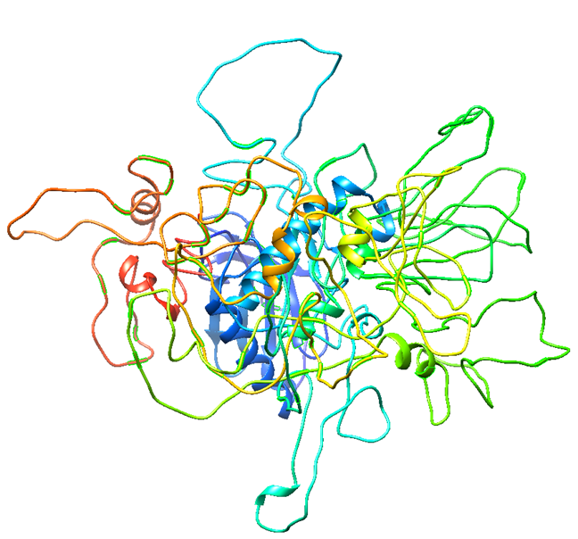
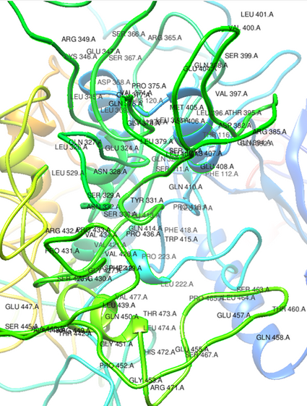
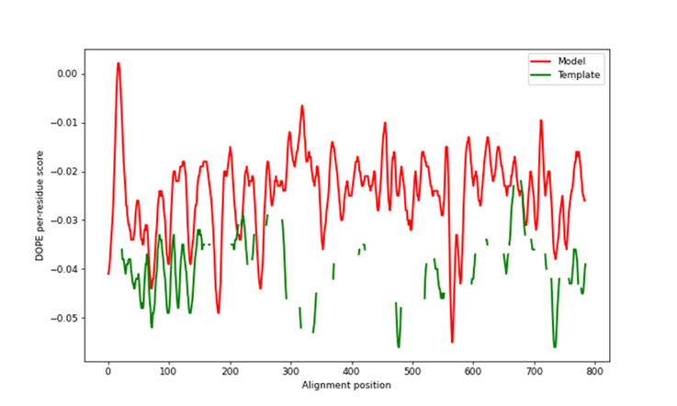

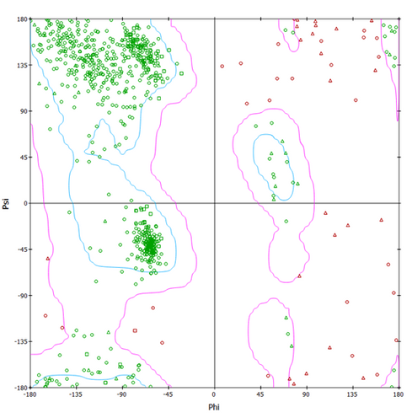
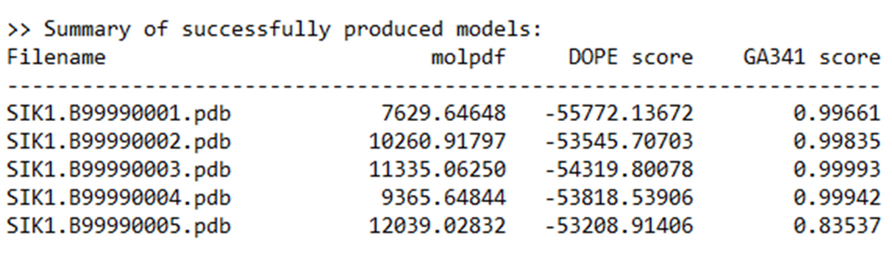
a)
b)
d)
c)
SIK1 (salt inducible kinase 1)
(a) Represent the structure of SIK1 and the active site surface, (b) Represent the Dope_Profile, (c) Represent the Dope_Score, (d) Represent the Ramachandran plot.

Slide 9
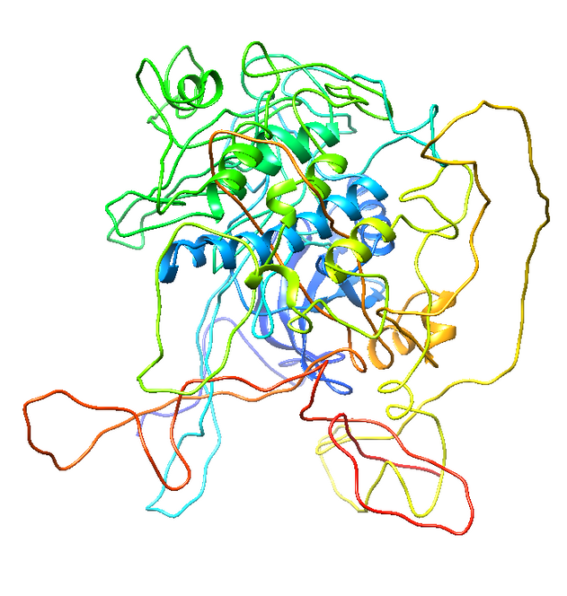
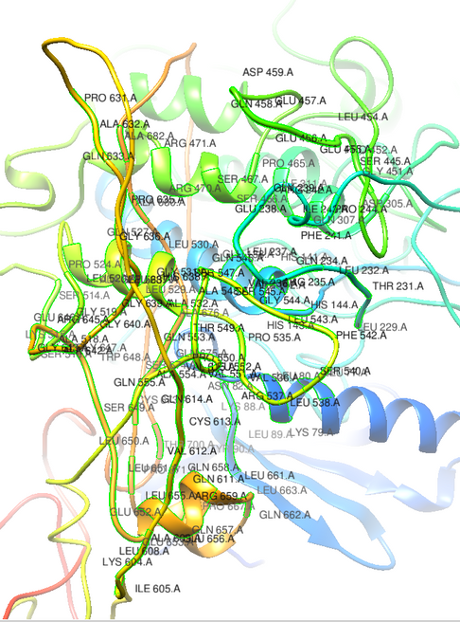
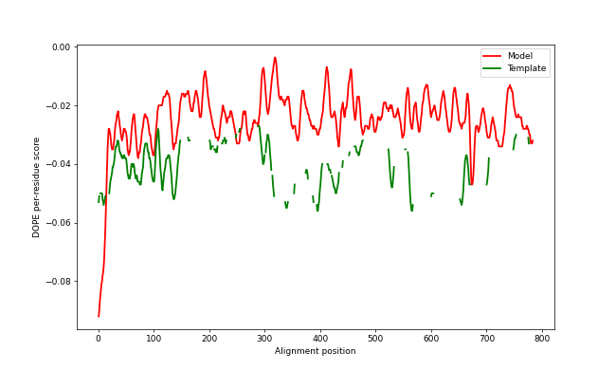
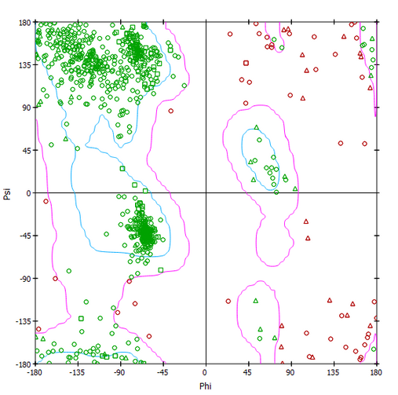
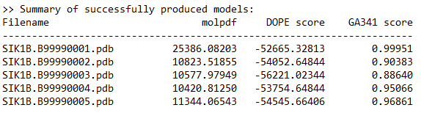
a)
b)
d)
c)
SIK1B (salt inducible kinase 1B)
(a) Represent the structure of SIK1 and the active site surface, (b) Represent the Dope_Profile, (c) Represent the Dope_Score, (d) Represent the Ramachandran plot.

Slide 10
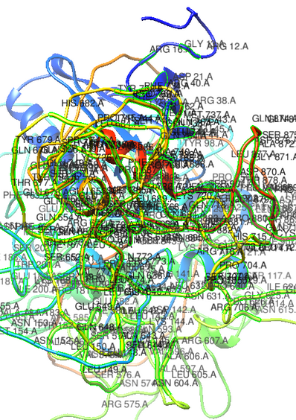
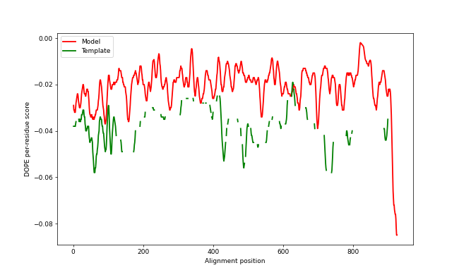
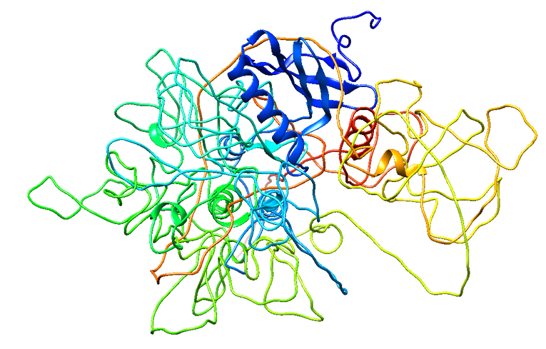
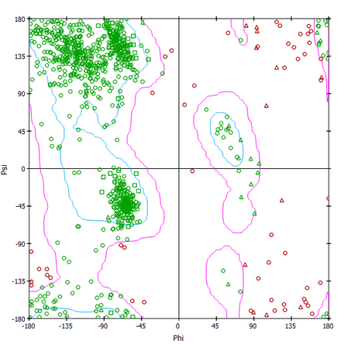
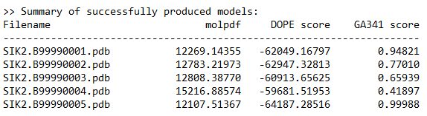
a)
b)
d)
c)
SIK2 (salt inducible kinase 2)
(a) Represent the structure of SIK1 and the active site surface, (b) Represent the Dope_Profile, (c) Represent the Dope_Score, (d) Represent the Ramachandran plot.

Slide 11
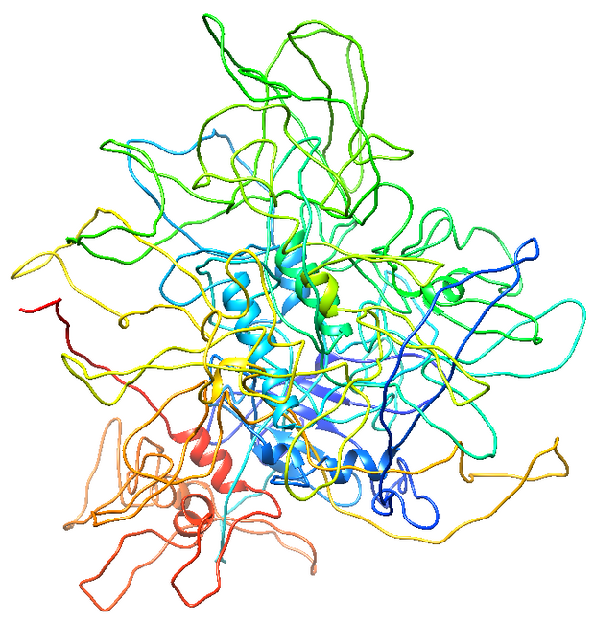
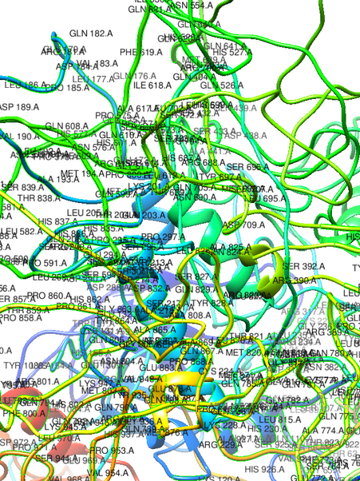
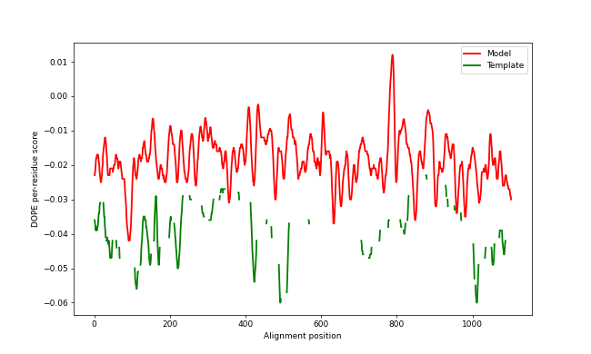
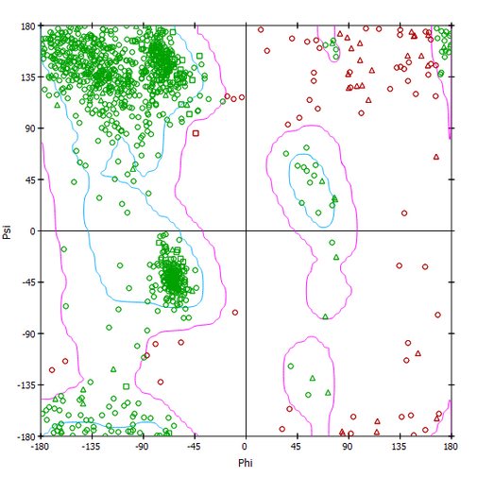
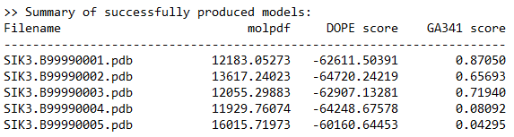
a)
b)
d)
c)
SIK3 (salt inducible kinase 3)
(a) Represent the structure of SIK1 and the active site surface, (b) Represent the Dope_Profile, (c) Represent the Dope_Score, (d) Represent the Ramachandran plot.

Slide 12
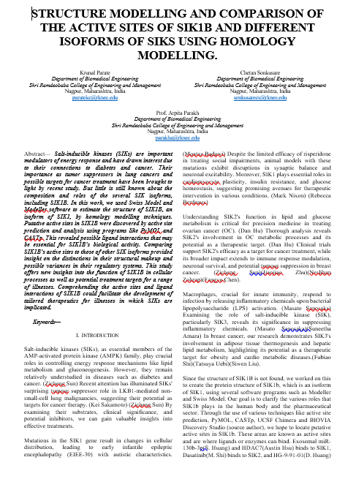
REWIVE PAPER
PAPER TITLE:
STRUCTURE MODELLING AND COMPARISON OF THE ACTIVE SITES OF SIK1B AND DIFFERENT ISOFORMS OF SIKS USING HOMOLOGY MODELLING.
ABSTRACT: Salt-inducible kinases (SIKs) are important modulators of energy response and have drawn interest due to their connections to diabetes and cancer. Their importance as tumor suppressors in lung cancers and possible targets for cancer treatment have been brought to light by recent study. But little is still known about the composition and roles of the several SIK isoforms, including SIK1B. In this work, we used Swiss Model and Modeller software to estimate the structure of SIK1B, an isoform of SIK1, by homology modelling techniques. Putative active sites in SIK1B were discovered by active site prediction and analysis using programs like PyMOL and CASTp. This revealed possible ligand interactions that may be essential for SIK1B's biological activity. Comparing SIK1B's active sites to those of other SIK isoforms provided insight on the distinctions in their structural makeup and possible variances in their regulatory systems. This study offers new insights into the function of SIK1B in cellular processes as well as potential treatment targets for a range of illnesses. Comprehending the active sites and ligand interactions of SIK1B could facilitate the development of tailored therapeutics for illnesses in which SIKs are implicated.

Slide 13
MOLECULAR DOCKING
Molecular docking is a computational technique used to predict the interaction between a small molecule (ligand) and a target protein or enzyme. It helps determine the best binding orientation and affinity of the ligand to the target, aiding in drug discovery and design.
AutoDock / AutoDock Vina – Free, widely used for ligand-protein docking.

Slide 14
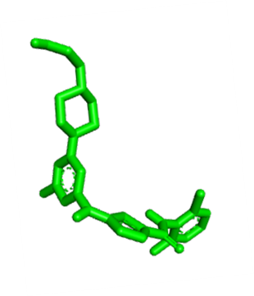
Ligand Used for Molecular Docking
Dasatinib; 302962-49-8; Sprycel; Dasatinib anhydrous; BMS 354825; Dasatinib (anhydrous); dasatinibum; N-(2-CHLORO-6-METHYLPHENYL)-2-({6-[4-(2-HYDROXYETHYL)PIPERAZIN-1-YL]-2-METHYLPYRIMIDIN-4-YL}AMINO)-1,3-THIAZOLE-5-CARBOXAMIDE; ...
Compound CID: 3062316
MF: C22H26ClN7O2S
MW: 488 g/mol
IUPAC Name: N-(2-chloro-6-methylphenyl)-2-[[6-[4-(2-hydroxyethyl)piperazin-1-yl]-2-methylpyrimidin-4-yl]amino]-1,3-thiazole-5-carboxamide
SMILES: CC1=C(C(=CC=C1)Cl)NC(=O)C2=CN=C(S2)NC3=CC(=NC(=N3)C)N4CCN(CC4)CCO
InChIKey: ZBNZXTGUTAYRHI-UHFFFAOYSA-N
InChI: InChI=1S/C22H26ClN7O2S/c1-14-4-3-5-16(23)20(14)28-21(32)17-13-24-22(33-17)27-18-12-19(26-15(2)25-18)30-8-6-29(7-9-30)10-11-31/h3-5,12-13,31H,6-11H2,1-2H3,(H,28,32)(H,24,25,26,27)
Create Date: 2005-08-09
Why Dasatinib Was Selected as Ligand?
Well-characterized and bioactive structure.
Suitable for repurposing studies in other cancers.
Strong binding affinity and multi-target potential.

Slide 15
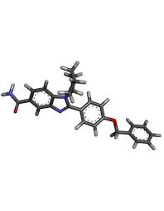
STEPS:
Protein and Ligand Retrieve
Cleaning of Protein and Ligand[
Preparation of Protein and Ligand
Grid preparation
Run on Command Prompt
Analysis

Slide 16
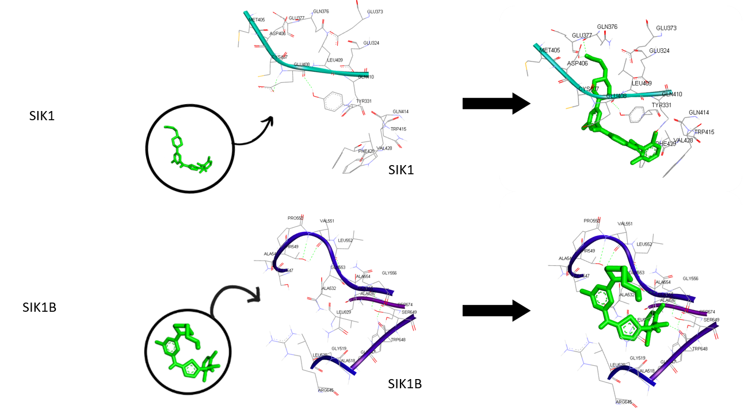
Docking Results of SIK1 vs SIK1B

Slide 17

Thank you!
By Krunal Parate and Chetan Sonkusare
Under the guidance of Dr. Arpita Parakh

